Slide 1
Lesson 2: Generating Code in SAS® Studio
2.1 Exploring Data
2.2 Creating Results with Tasks
2.3 Using Code Snippets

Slide 2
Lesson 2: Generating Code in SAS® Studio
2.1 Exploring Data
2.2 Creating Results with Tasks
2.3 Using Code Snippets

Slide 3


Exploring Data
Notes:
When you open a table in SAS Studio, you use the table viewer. The table viewer enables you to interactively view and query data. Choosing the columns to display, applying filters, and sorting the data are just some of the actions that you can take.

Slide 4
Opening SAS Studio and Viewing Data
This demonstration illustrates exploring a SAS table using the graphical user interface.

Slide 5
Questions?

Slide 6
Practice
This practice reinforces the concepts discussed previously.

Slide 7
Lesson 2: Generating Code in SAS® Studio
2.1 Exploring Data
2.2 Creating Results with Tasks
2.3 Using Code Snippets

Slide 8
What Are Tasks and Utilities?
Tasks and utilities guide users through analytical and data-preparation processes.
Notes:
Tasks and utilities are point-and-click interfaces that guide you through analytical and data-preparation processes. Tasks and utilities generate SAS code as well as formatted results. They prompt the user for table names and options. SAS Studio is shipped with predefined tasks and utilities that are based on SAS procedures. You can also create your own tasks.

Slide 9
Discussion
Select Tasks and Utilities in the Navigation pane and expand each section. Which tasks might be helpful in your work?

Slide 10
Utilities
PROC IMPORT
PROC SQL
Notes:
Utilities are available to import and query data. Using the Import Data utility, you can certain types of data files into SAS Studio, and SAS Studio generates PROC IMPORT code.
The Query utility enables you to extract data from one or more tables according to user-specified criteria. SAS Studio generates PROC SQL code for you.

Slide 11
Saving Tasks and Utilities
.CTK
SAS Studio Task Template
.CQY
SAS Studio Query
.CTL
SAS Studio Import Data
Notes:
If you use a task or utility frequently, you might want to save it after you specify the settings. In SAS Studio, you can save a task as a CTK file, a instance of the Query utility as a CQY file, and an instance of the Import Data utility as a CTL file. The next time you need to use that item, you simply double-click the name in the navigation pane and it appears with all of your previous settings.

Slide 12
2.01 Activity
Select Tasks and Utilities in the Navigation pane. Expand Utilities and double-click Import Data. You might need to collapse the Tasks section to see the Utilities section.
Select Files and Folders in the Navigation pane. If necessary, expand Folder Shortcuts ⇨ SAS Studio Basics.
Drag the Sales.xlsx file to the work area.
Notice that PROC IMPORT code is generated. Run the program and examine the OUTPUT DATA and RESULTS tabs.
Notes:
Type answer here

Slide 13
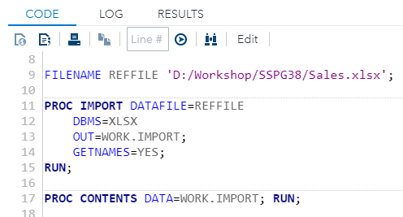
2.01 Activity – Correct Answer
Notice that PROC IMPORT code is automatically generated.

Slide 14
2.02 Multiple Answer Question
Examine the Options section of the Import Data utility. Which of these file types can be imported? (Select all that apply.)
Microsoft Access
Microsoft Excel
CSV (comma-delimited)
delimited file with any delimiter
Notes:
Correct Answers: a, b, c, d (all file types listed can be imported.)

Slide 15
2.02 Multiple Answer Question – Correct Answers
Examine the Options section of the Import Data utility. Which of these file types can be imported? (Select all that apply.)
Microsoft Access
Microsoft Excel
CSV (comma-delimited)
delimited file with any delimiter
Notes:
Correct Answers: a, b, c, d (all file types listed can be imported.)

Slide 16
Using the Bar Chart Task
This demonstration illustrates the use of the Bar Chart task to create a SAS program.

Slide 17
Questions?

Slide 18
Practice
This practice reinforces the concepts discussed previously.

Slide 19
Lesson 2: Generating Code in SAS® Studio
2.1 Exploring Data
2.2 Creating Results with Tasks
2.3 Using Code Snippets

Slide 20
What Is a Snippet?
Notes:
Code snippets allow you to quickly customize code to meet your needs by enabling insertion of saved SAS code into your program. SAS Studio is shipped with several code snippets. You can also create your own snippets.

Slide 21
2.03 Activity
Press the F4 key to create a new program tab.
Select Snippets in the Navigation pane. Expand Snippets ⇨ Data. Drag Generate PowerPoint Slide onto the PROGRAM tab.
Do not make any changes and submit the program.
Click Open when you are prompted to open the .pptx file. If necessary, click sgplot.pptx in the lower left corner to view the file.

Slide 22
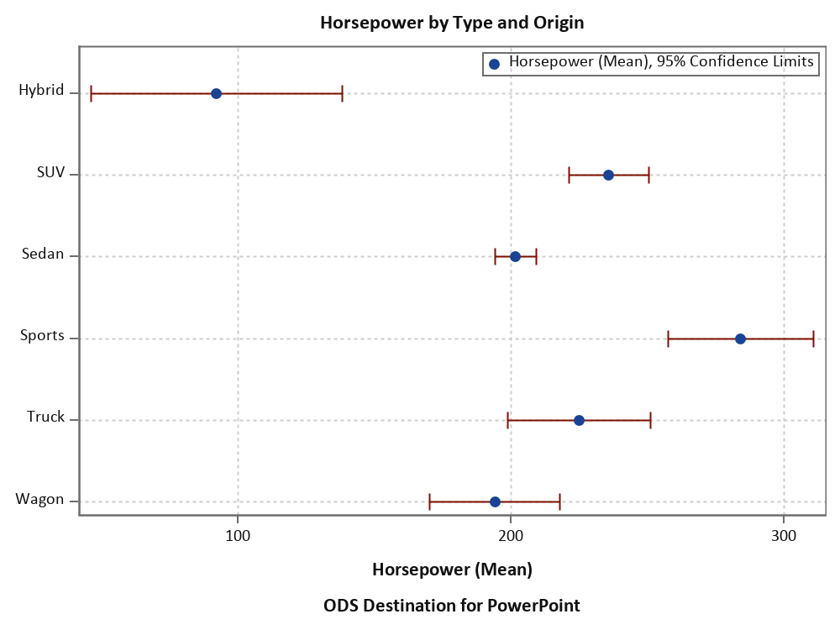

Slide 23
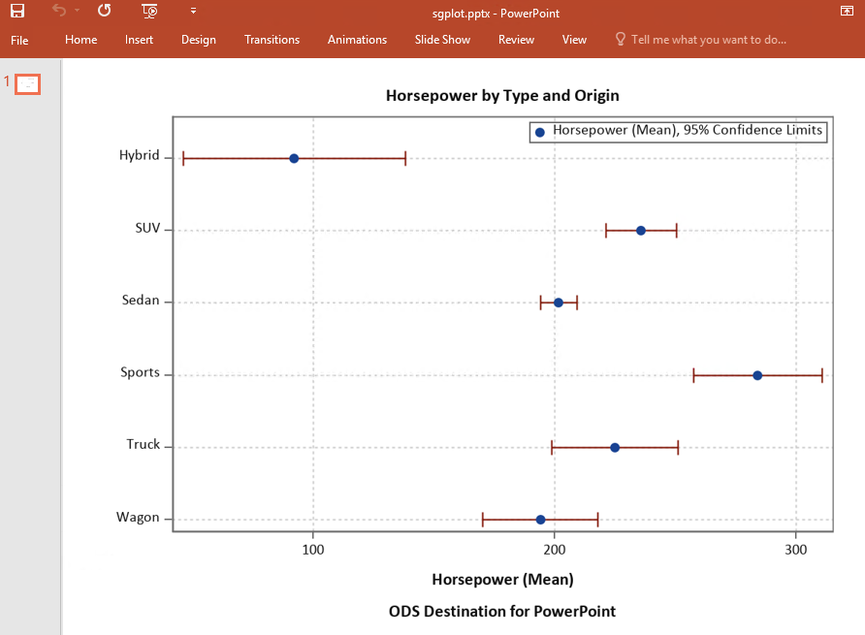
2.03 Activity – Correct Answer
This code snippet created a PowerPoint slide containing a dot plot.

Slide 24
Using Code Snippets
This demonstration illustrates creating a new snippet and editing an existing snippet to create a PowerPoint slide.

Slide 25
Questions?

Slide 26
Practice
This practice reinforces the concepts discussed previously.

Slide 27
Beyond SAS Studio Programming
What if you want to ...
. . . practice SAS Studio Programming?
. . .learn more about SAS Studio Programming?
. . . ask questions and share ideas?
Download a free learning version of SAS Studio. Search for SAS University Edition.
Visit our SAS Studio Video Library.
Connect with other SAS Studio users on the SAS Studio Community Page.

